Slide 1
Chapter 11
Discrimination and Classification

Slide 2
11.1 INTRODUCTION
Discrimination and classification are multivariate techniques concerned with separating distinct se-ts of objects (or observations) and with allocating new objects (observations) to previously defined groups. Classification ordinarily requires more pr-oblem structure than discrimination does.
Thus, the immediate goals of discrimination and classification, respectively, are as follows:

Slide 3
Goal 1. To describe, either graphically (in th-ree or fewer dimensions) or algebraically, the diff-erential features of objects (observations) from se-veral known collections (populations). We try to find “discriminants” whose numerical values are such that the collections are separated as much as possibles.
Goal 2. To sort objects (observations) into two or more labeled classes. The emphasis is on

Slide 4
deriving a rule that can be used to optimally assi-gn new objects to the labeled classes.
We shall follow convention and use the term discrimination to refer to Goal 1. This terminolo-gy was introduced by R. A. Fisher [9] in the first modern treatment of separative problems. A more descriptive term for this goal, however, is separa-tion. We shall refer to the second goal as classific-ation or allocation.

Slide 5


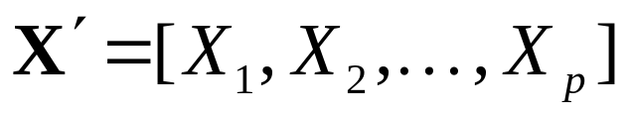

11.2 SEPARATION AND CLASSIFICATION FOR TWO POPULATIONS
To fix ideas, let us list situations in which one may be interested in (1) separating two classes of objects or (2) assigning a new object to one of two classes (or both). It is convenient to label the clas-ses and . The objects are ordinarily separated or classified on the basis of measurements on, for instance, p associated random variables
. We can think of the totality of values from the first class as being the population of values for and those from the second class

Slide 6
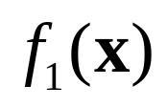
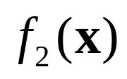
as the population of values for . These two populations can then be described by probability density functions and , and consequently, we can talk of assigning observations to populati-ons or objects to classes interchangeably.

Slide 7
Example 11.1 (Discriminating owners from nono-wners of riding mowers)
P.584

Slide 8




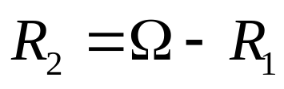
Let and be the probability density functions associated with vector random vari-able for the populations and , respectively. An object with associated measurements must be assigned to either or . Let be the sample space—that is, the collection of all possible obser-vations . Let be that set of values for which we classify objects as and be the re-maining values for which we classify objects as . Since every object must be assigned to one

Slide 9

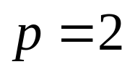
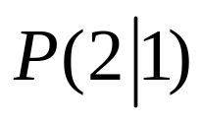
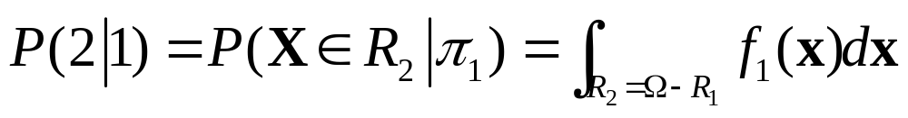
and only one of the two populations, the sets and are mutually exclusive and exhaustive. For , we might have a case like the one pictu-red in Figure 11.2.
The conditional probability, , of classify-ing an object as when, in fact, it is from is

Slide 10
Example 11.2 (Classifying a new observation into one of the two populations)
P.589

Slide 11
11.3 CLASSIFICATION WITH TWO MULTIVARIATE NORMAL POPULATIONS

Slide 12

Example 11.3 (Classification with two normal populations-common and equal costs)
P.593

Slide 13
11.4 EVALUATING CLASSIFICATION FUNCTIONS

Slide 14
Example 11.7 (Classifying Alaskan and Canadian salmon)
P.606

Slide 15
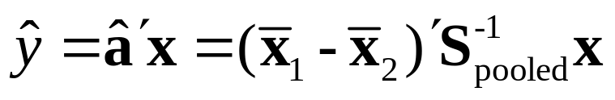
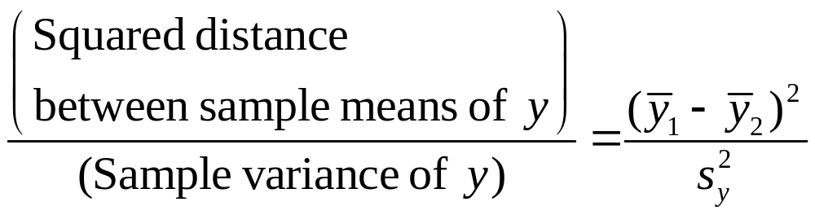
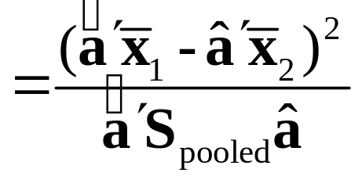
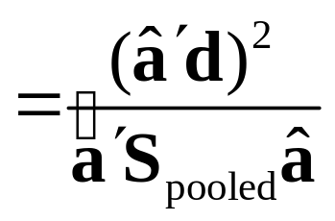
11.5 FISHER’S DISCRIMINANT FUNCTION---SEPARATION OF POPULATIONS
Result 11.4. The linear combination
maximizes the ratio

Slide 16
Example 11.11 (Classifying a potential business-school graduate student)
P.620

Slide 17
Example 11.12 (Effective classification with few-er variables)
P.626
In his pioneering work on discriminant functions, Fisher [8] presented an analysis of data collected by Anderson [1] on three species of iris flowers. (See Table 11.5, Exercise 11.27.)

Slide 18
11.7 FISHER’S METHOD FOR DISCRIMINATING AMONG SEVERAL POPULATIONS

